Slide 1
Exploring the details of APEX sessions
APEX Connect 2018, Apr 26, 2018
Notes:
Thank you for joining me tonight.
I did a few other presentations this year and they were all about advanced features or usage, mostly JavaScript.
But a while ago I had a problem and needed to understand how APEX sessions work exactly. I did a lot of investigation and found interesting thing along the way that I didn’t knew or just took for granted.
I realized it helped a lot knowing about all these little details and how everything works together to create stateful behavior in APEX.
You don’t get statefulness in web applications by default. It has to be created by your framework, in our case APEX.
And besides that, APEX includes a few hidden gems regarding sessions I want to tell you about.

Slide 2
Today’s menu
Introduction
Creating a session
The login process
Session state
Smaller session features
The logout process
Notes:
So today is all about APEX sessions.
We will start at the beginning, creating a new session, logging in, looking at how we interact with the session along the way.
Finally we’ll logout again and by then we should know how sessions work in great detail.
It’s my first webinar, please feel free to ask questions

Slide 3

HTTP Protocol
Web server
HTTP request messages:
GET www.google.com HTTP/1.1
User-Agent: Mozilla/5.0
Accept-Language: en-us
Accept-Encoding: gzip, deflate
Connection: Keep-Alive
HTTP response messages:
HTTP/1.1 200 OK
Content-Length: 88
Content-Type: text/html
Connection: Closed
<html>
<body>
<h1>Hello, World!</h1>
</body>
</html>
Browser
Notes:
So with APEX, we create web applications. And the web uses the HTTP protocol to send data to the server and return data to clients.
For instance this is what would happen if we go to the browser, and enter googles URL.
From the client, a GET request is made. The URL brings you to a Google webserver. It processes the request and give some response message back in return.
In this case, HTTP status code 200 means that it’s OK and gives HTML content, which the browser uses to create a page with.
The server by default does not care which client does the request, It returns the same message to every client.

Slide 4
HTTP is stateless
Web server
User 1
User 2
User 3
User 4
Notes:
There is no stateful connection between a client and the server.
If we want to create such a thing, we need to send session information in our requests.
The most common way to do this is via cookies.

Slide 5
What is a session?
“A session establishes stateful behavior across pages for each user”

Slide 6
How does APEX create a session?

Slide 7
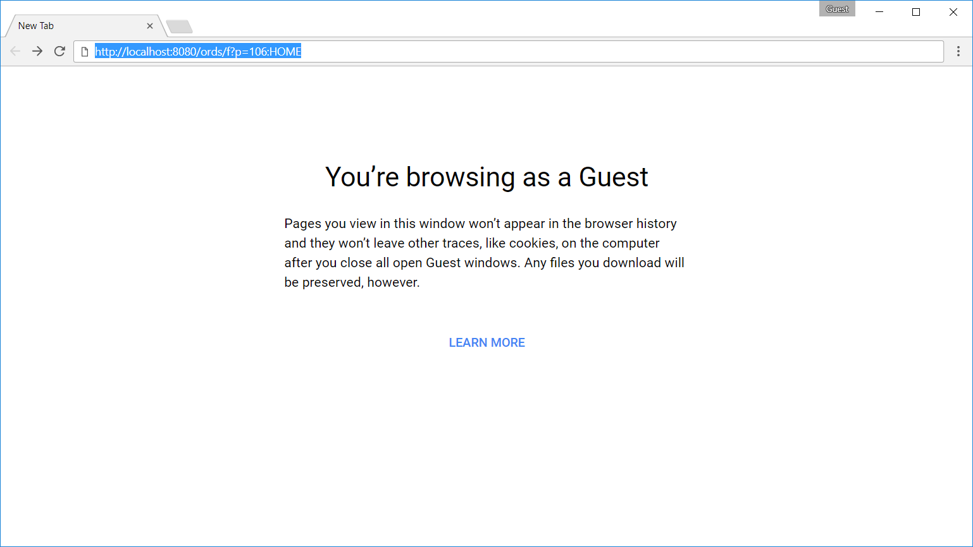
Notes:
Here you can see that I opened up a new and empty browser window. I have a link to an APEX page which I want goto. Maybe this comes from a bookmark or something.
We all know that I won’t be allowed to see this page when authentication is required. But lets see in detail what actually happens.

Slide 8
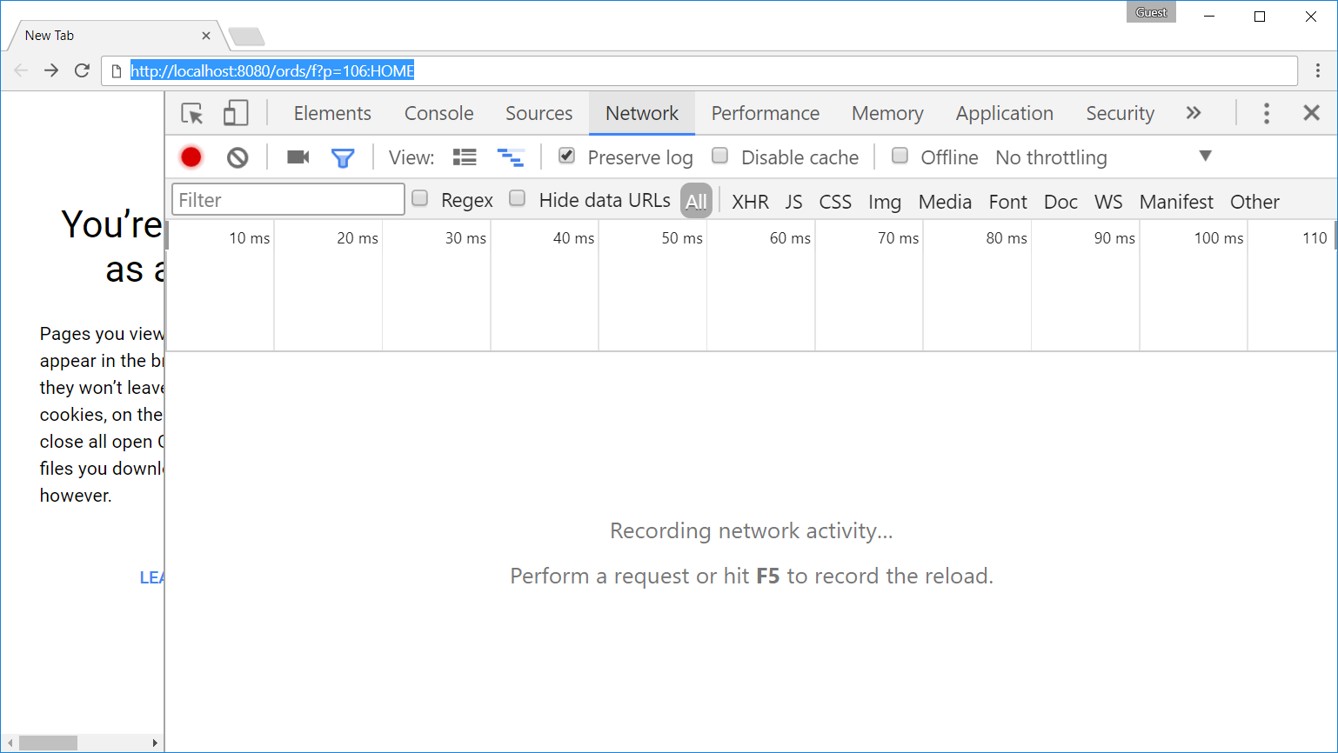
Notes:
First thing to do is open up the developer console in Google Chrome.
We can log all the HTTP Requests the client makes. We have to check the Preserve log option to do so.
Then, actually make the request, hit enter in the URL field.

Slide 9
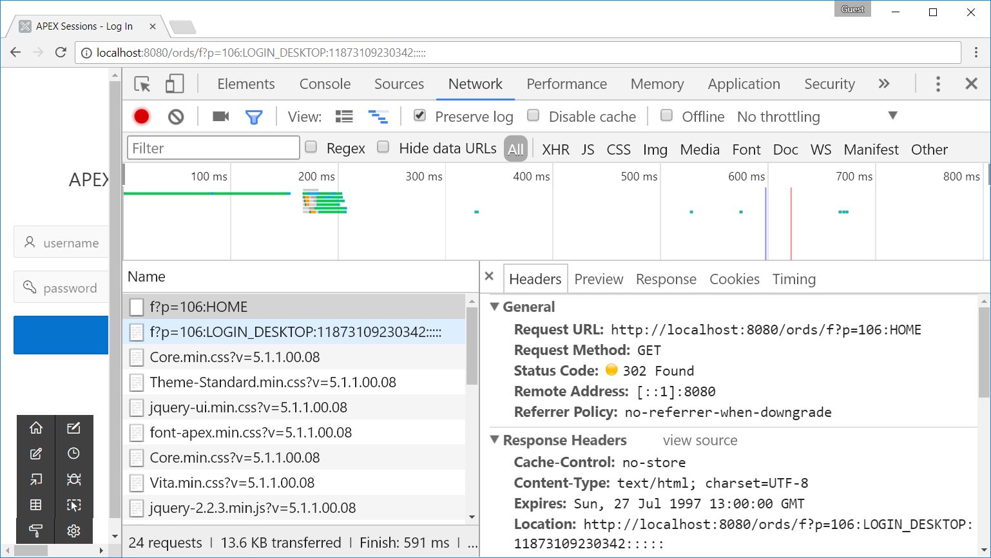
The HTTP response status code 302 Found is a common way of performing URL redirection.
Notes:
Now we have a log of requests.
The one op top is the oldest request, so our starting point.
As you can see, we requested the HOME page.
But we received HTTP status 302. What is 302?
It tells the browser to make another request to a specified URL
What was the specified URL? The LOGIN page
So somehow APEX managed to check that we didn’t have a valid session and performed a redirect to the login page.

Slide 10
What happened in APEX?
1
Check if the session is valid
2
Create a new session for user “nobody”
3
Redirect to the “session not valid URL”
Notes:
We saw what happened on the client. Now lets look a the server side of things.
Three things have happened in APEX.
First, did we have a valid session? If not, redirect to a URL.
And when we landed on the login page, a new session was created for user “nobody”
User “nobody” is a special kind of user and we’ll find more about it soon.

Slide 11

1. Check if the session is valid
How depends on your Authentication Scheme
If a sentry function exists, it will use that one.
If a sentry function does not exist, it will use the internal one.
Authentication Scheme Cookie
Session ID in Request
Valid?
Notes:
How does APEX check if a session is valid or if a session exists?
If didn’t know what the meaning of the word sentry was, but I’ve checked and the meaning is like a guard at a military base.
Maybe you haven’t heard about this function, nore used it explicitly. But it is executed for every apex request.
The internal sentry function checks the contents of the authentication scheme cookie and the session ID in the request. If the combination is valid, then your session is valid.
If not, we get redirected.

Slide 12
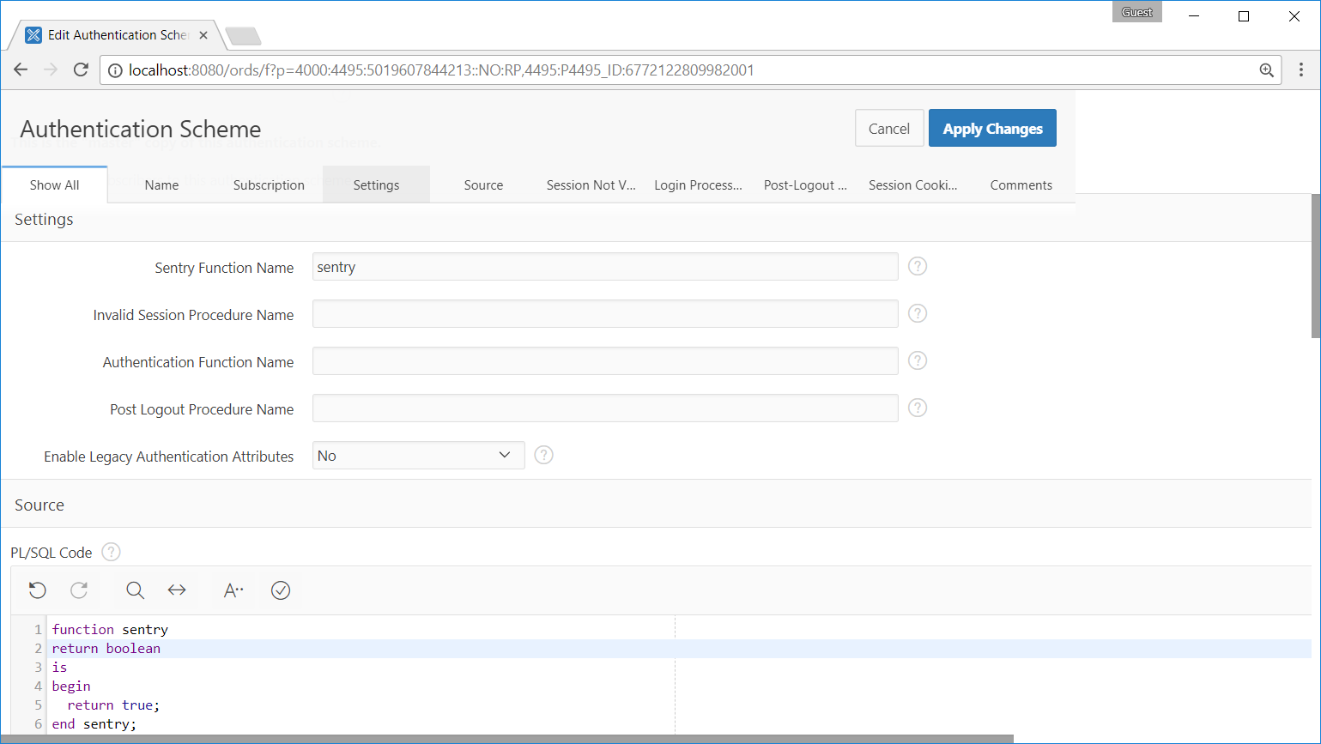
This is a custom Authentication Scheme
Notes:
The sentry function is part of the Authentication Scheme setting in Shared Components.
You may refer to a database object or to a function which you have written below.
If we look at my function here, that always returns true. What do you think would happen if we try to access any page with authorization of our application?
Anybody would have immediate access to every page!! This is a very powerful function.

Slide 13
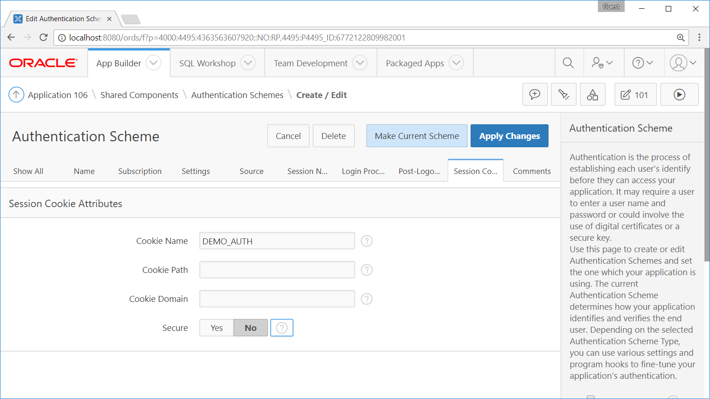
HTTPS only?
Notes:
Here you see the section in shared components, authentication scheme, session cookie attributes.
As I said you can give the cookie a now, if no name is provided, a default name is used.
Then we have three other options.
The cookie path: A URL path must exist in order for the cookie to be sent to the client
The cookie domain: The hosts to which the cookie will be sent
Secure: Only send the cookie when there is a HTTPS connection

Slide 14
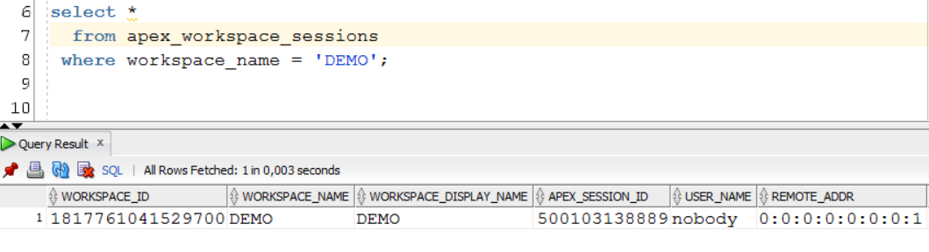
2. Create a new session for user “nobody”
Even before login, a new session is created
Tip: use apex_dictionary view
select *
from apex_dictionary
where apex_view_name like '%SESSION%'
and column_id = 0;
Tip: grant role to schema to see all data
grant apex_administrator_role to <SCHEMA>;
Notes:
We can query the session table. APEX includes a lot of views that can be of great value.
Let your starting point be the apex_dictionary view. And if possible, grant the user which queries these views the apex_administrator_role.
If you would use for example your parsing schema from the application and not have this role, you would only see data for that workspace.

Slide 15
3. Redirect to the “session not valid URL”
Only when sentry returns false
Notes:
For us, executing the sentry function returned false so we need to redirect to a url

Slide 16
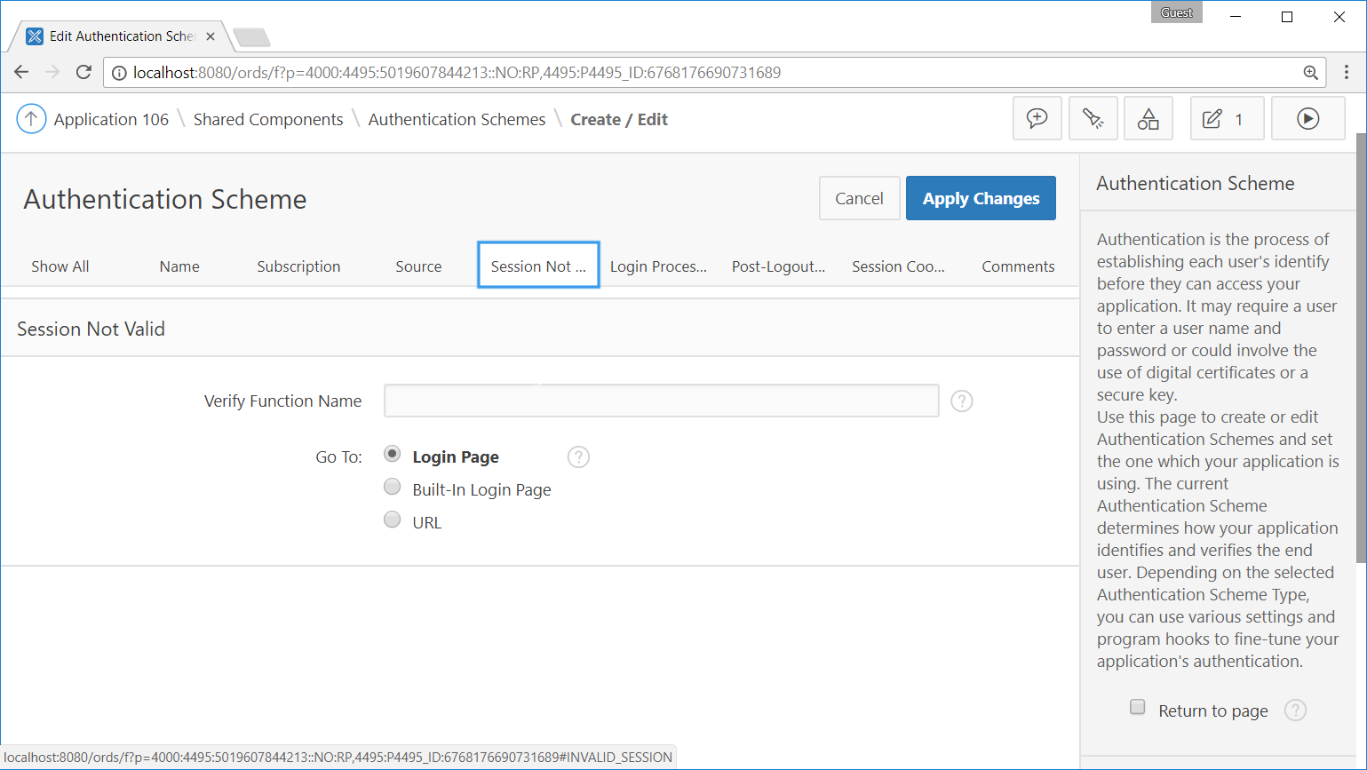
Notes:
And where to redirect to is part of the session not valid attributes in our authentication scheme. In this case we refer to the login page, which is set at user interface attributes.

Slide 17
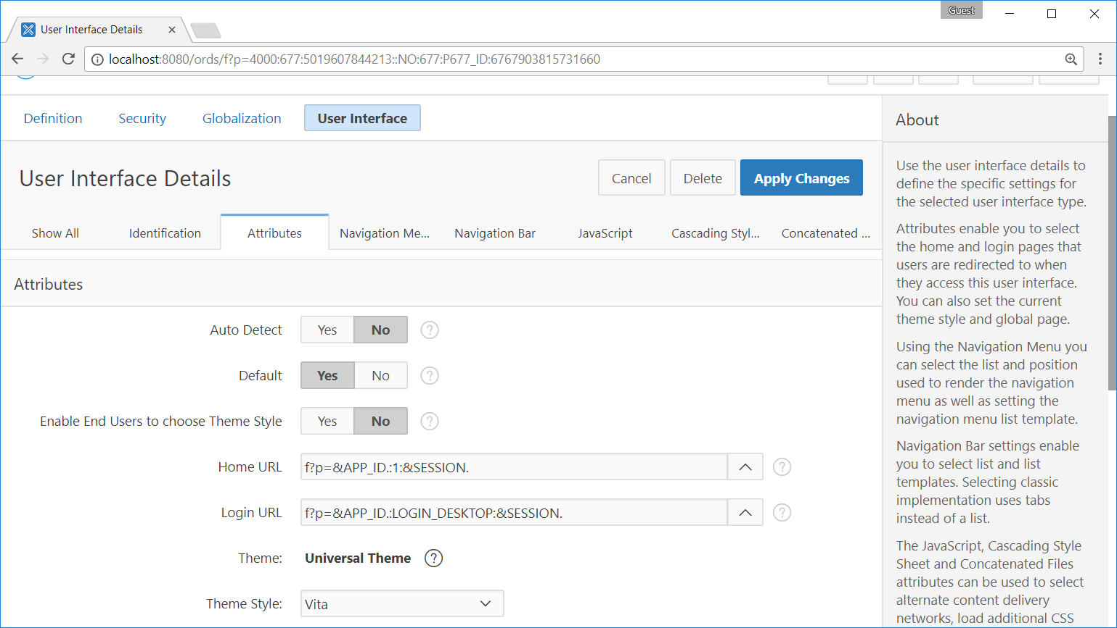
Notes:
For our desktop user interface, we see the final value of our Login URL.

Slide 18
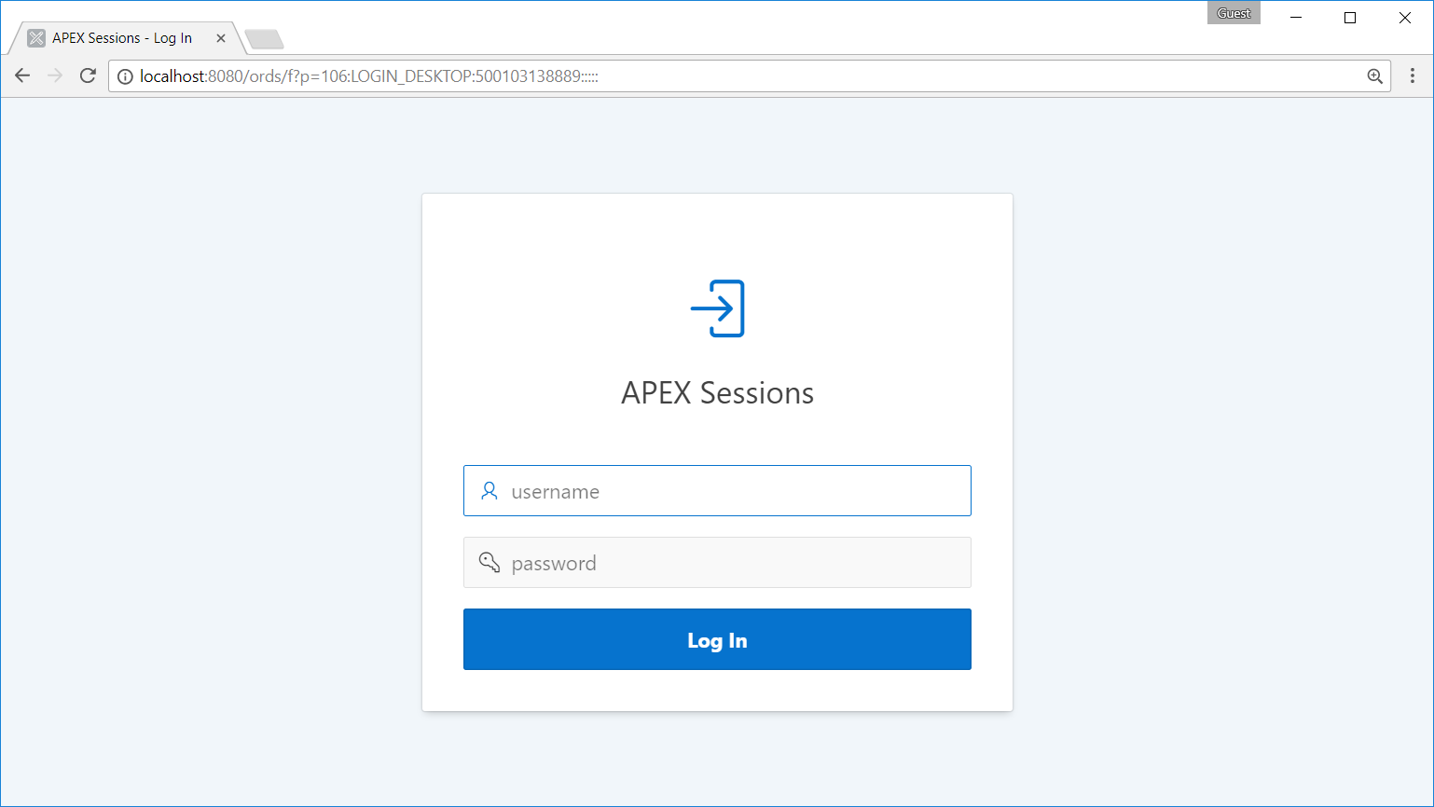
Notes:
And indeed, on the client, we are redirected to this very page.
As you can see we were not only redirected, we also received a new APEX session with an ID.
It might be strange at first that a session is created before login right??
But think about limiting the amount of login attempts and setting login timeouts on the client. A session provides a way to identify the same client even before login to do these things.

Slide 19
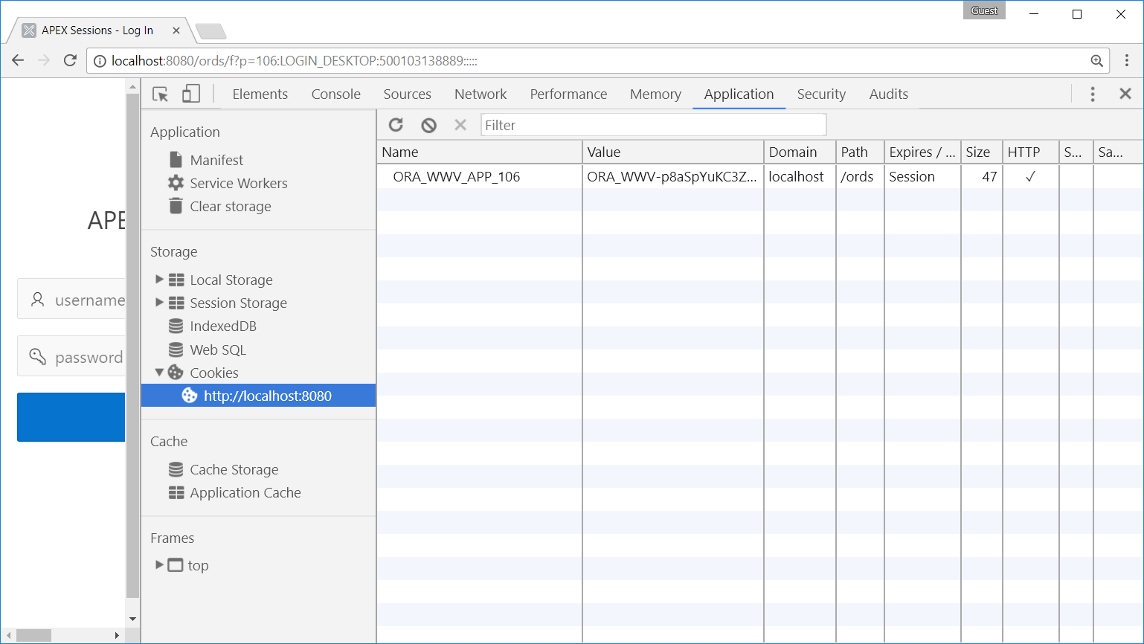
Notes:
We did not only get a session ID, but also the corresponding cookie. The cookie content is unreadable and probably contains a unique encrypted key which is decrypted on the server to find the correct session id.

Slide 20
The login process
Notes:
A lot of security features covered but we haven’t actually logged in yet.

Slide 21
Authentication Process
Authentication
Pre Authentication
Post Authentication
apex_authentication
.login
Notes:
Maybe you have seen this function to. Another login function but in a different package. This is basically a wrapper for the login procedure but supports a few extra things like support for preserved case usernames.
These extra things only make sense for custom authentication schemes.
In this chart we see can also do things just before login (pre authentication). Might be useful to log authentication attempts or something.
Then the custom login wrapper which executes the default login function.
Finally post authentication. In here you would typically initialize APPLICATION ITEMS or any form of context for the session.

Slide 22
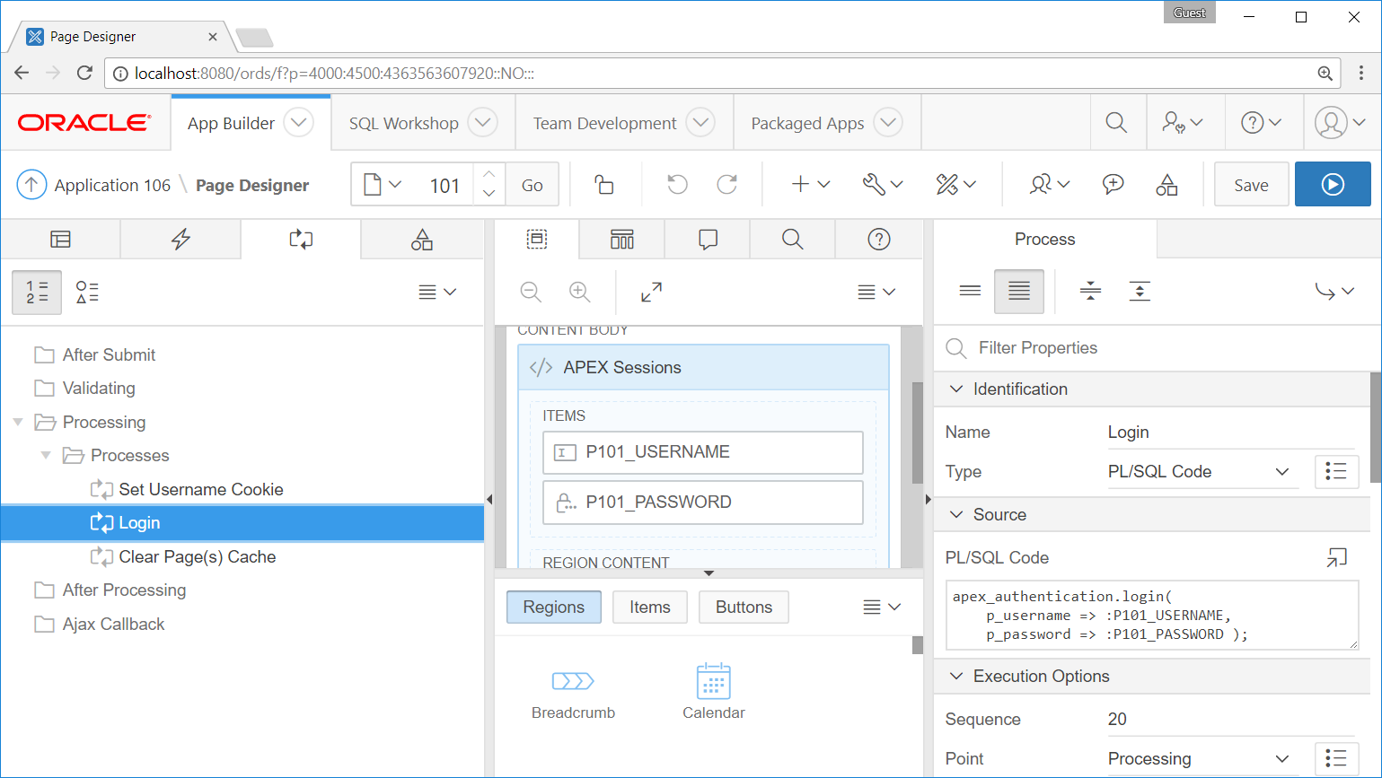
Notes:
This is our login page, with the username and password item.
On page submit, we use these page items to perform authentication.

Slide 23
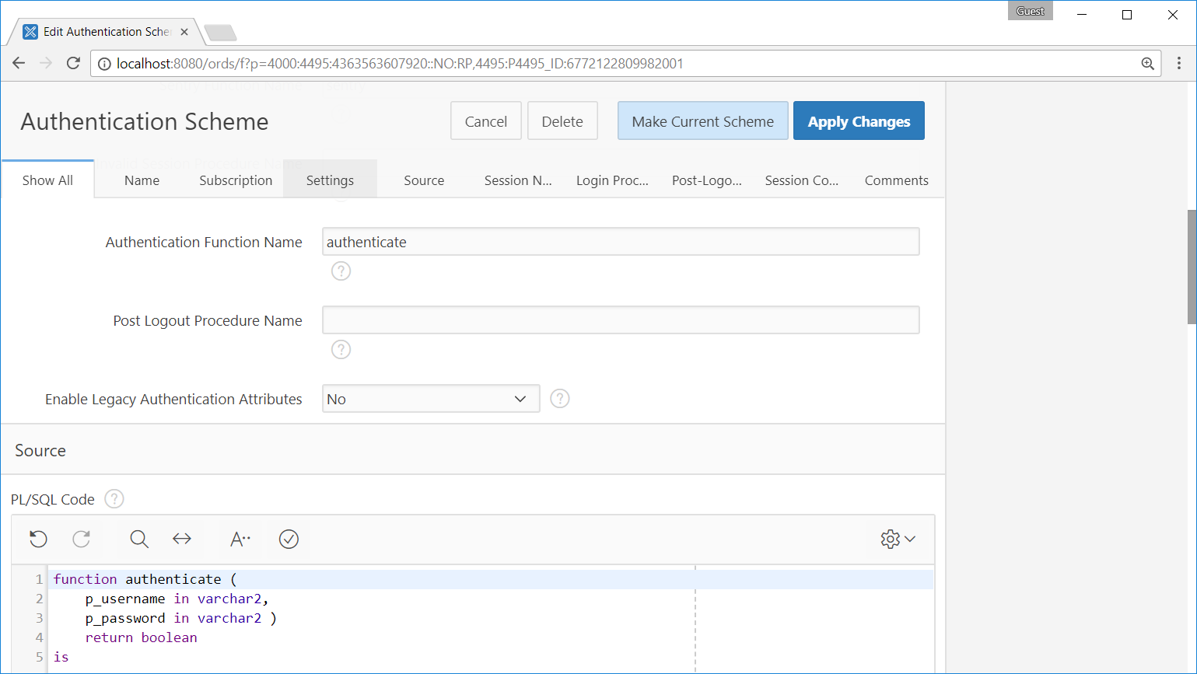
Notes:
apex_authentication.login will call your speficied authentication function. It has two parameters, again, username and password.
In this function you will check if the user is valid and the password is correct. This function should not do anything extra.

Slide 24
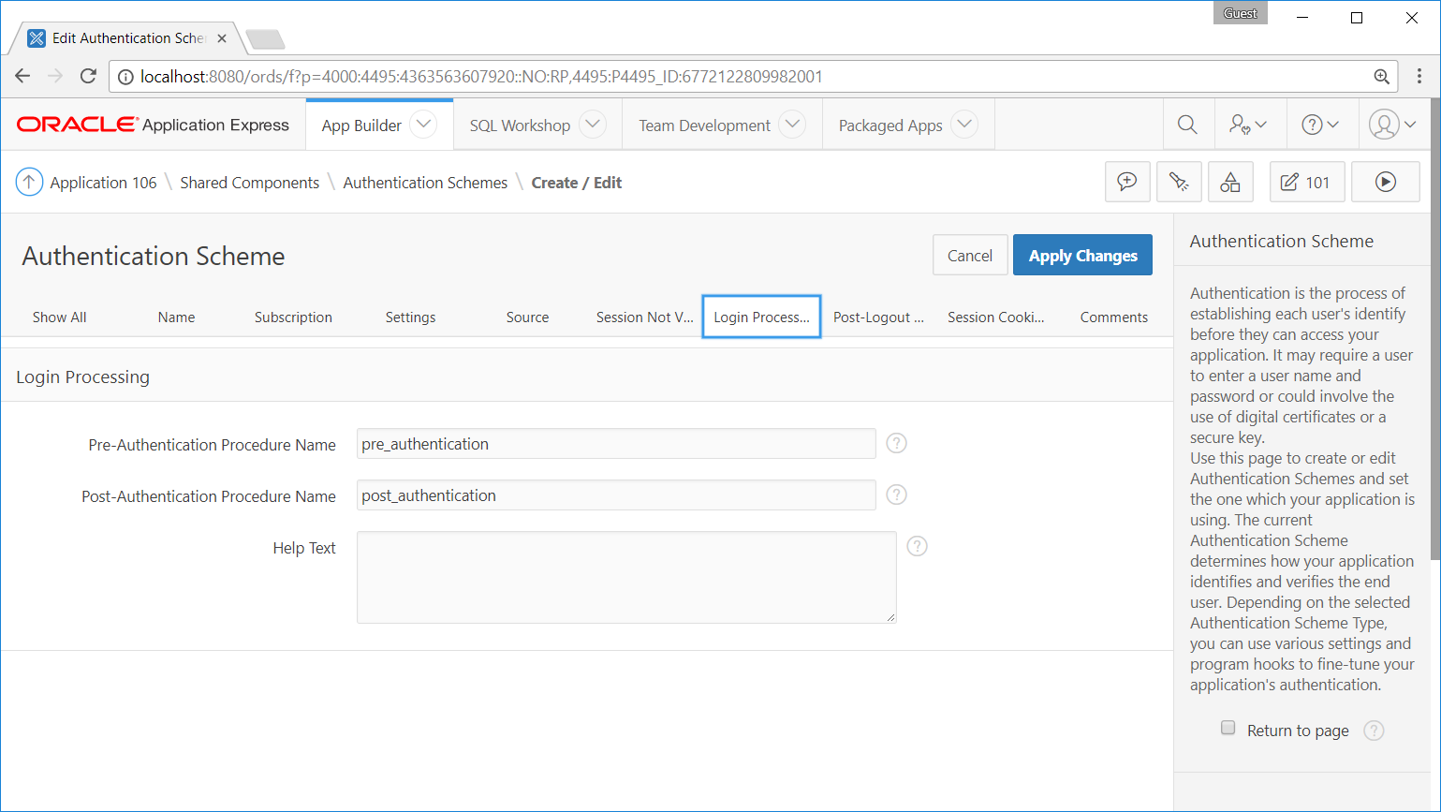
Tip: FSP_AFTER_LOGIN_URL in Post Authentication
Purpose:
Do not go to predefined home page, but redirect to custom URL
:FSP_AFTER_LOGIN_URL := apex_page.get_url(p_page => 2)
Notes:
The post authentication is also the place to change the redirection URL after login.
There is a special application item name FSP_AFTER_LOGIN_URL which does this trick. Even when you have a page with Deeplinking it will override that value.
I will talk about deeplinking in a moment.

Slide 25
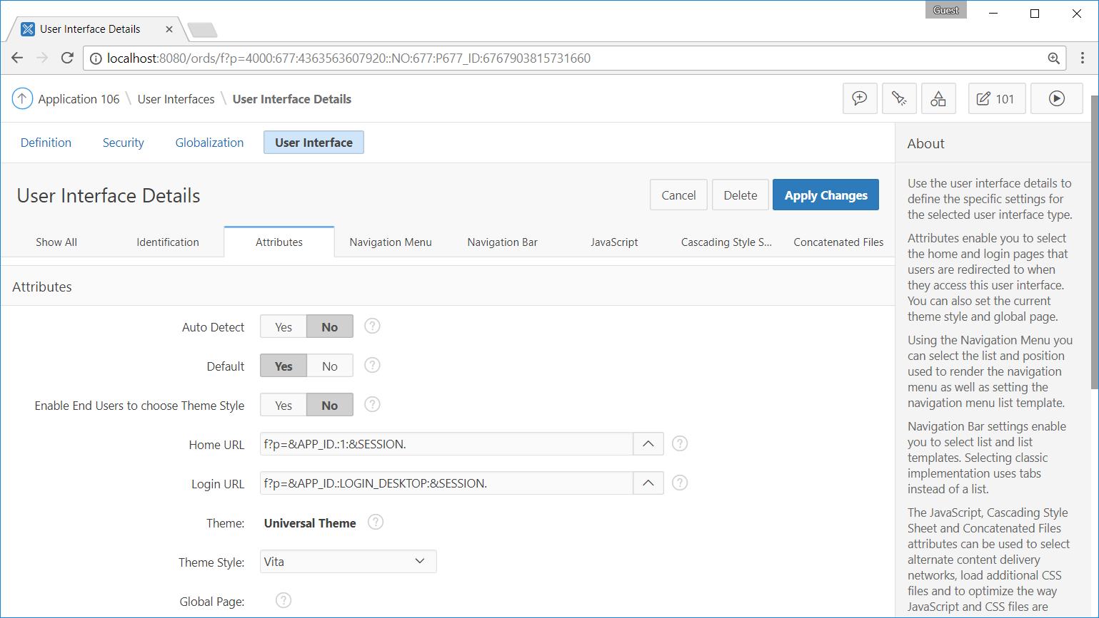
Notes:
The home url, which by default you are directed to, is part of the user interface attributes.

Slide 26
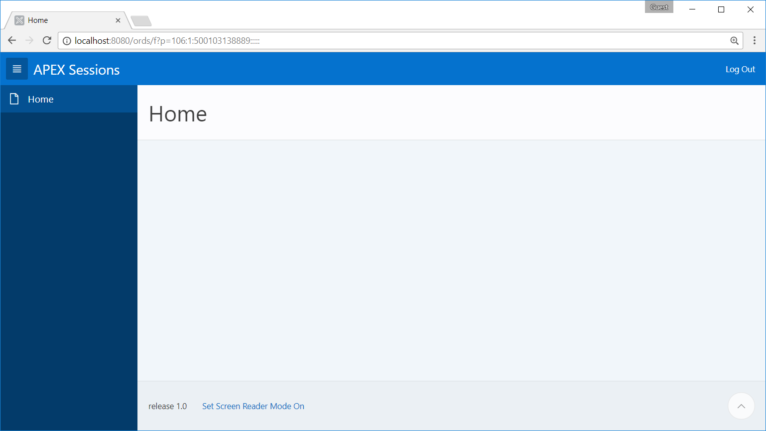
Notes:
And now we are finally logged in. On thing to notice is that we still got the same session id that we received before login.

Slide 27
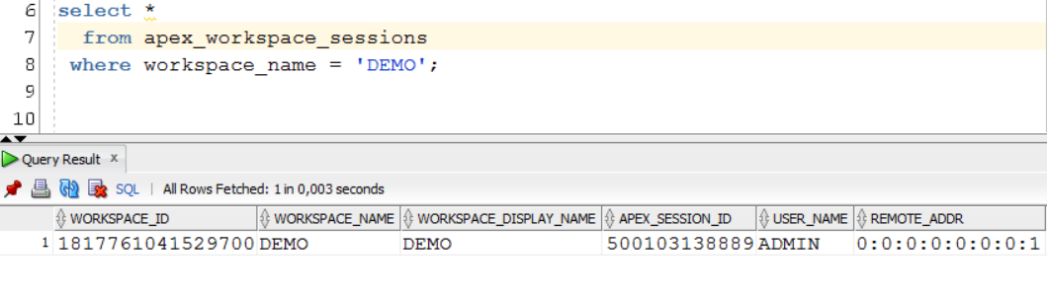
Update session for user “nobody” to “ADMIN”
Notes:
So APEX has updated the sessions table and changed the user_name column to our admin username.

Slide 28
Session State – Page Rendering

Slide 29
There are different kinds of session state
1
In Memory Session State
2
Persisted Session State
Difference: is or is not stored in WWV_FLOW_DATA table

Slide 30
In Memory Session State
1
Automatic Row Fetch
2
Page item default value
3
Page item source value
Notes:
So there values are not stored in a table when assigned.
Why?
The automatic row fetch calculated the source for page items
Both the source and default attribute are not the new final value of the item, it’s just a suggestion. We have to submit the real values in order to make then persisted.
Computations are real assignments of new values to items, so they are final.

Slide 31
Demo

Slide 32
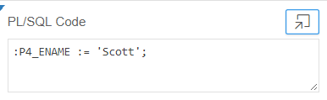
Persisted Session State
1
Computation
2
PL/SQL Process
Notes:
Persisted session state means saving item values in a table.
This is done for computations and PL/SQL Processes.

Slide 33
Persisted Session State - When does the commit take place?
1
If item value has changed using apex_util.set_session_state -> immediately
2
If item value has changed -> end of block
3
If no item value has changed -> end of page rendering
Notes:
These values are stored in the table.
When does the commit take place?
If page item value has changed -> end of process point
If no page item value has changed -> end of page rendering

Slide 34
Demo

Slide 35
Session State – Page Processing

Slide 36
What’s new in 5.1
1
Page submissions always via JSON
2
Reload on submit provides asynchronous page submits
Notes:
APEX 5.1 has introduced Asynchronous Page Submits
Instead of submitting the whole page, APEX makes an AJAX request with the complete page data as json object.
If validations fail or errors occur, you can the the message instantly instead of first reloading the whole page.
The Reload on submit feature is new and has to work together with the two other options.
Lets take a look.

Slide 37
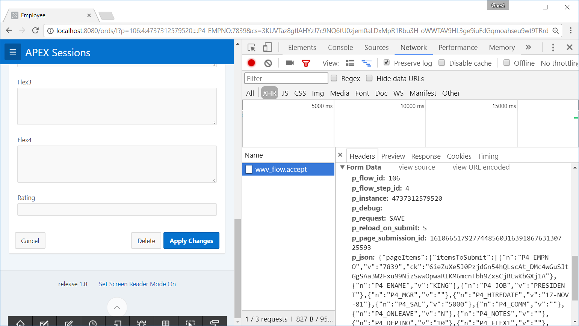
Always submit via JSON
Processed via APEX_APPLICATION.ACCEPT
Original JSON in APEX_JSON variables
Notes:
From now on, always processed as JSON. Fact.
This JSON object contains every pageItem on the page.
A request is made the the accept procedure. This will update the session state of all the page items. Everything is perstisted.

Slide 38
XMLHttpRequest page submits and the 32k limitation
People often mix up three limitations on 32K.
32K was the max size of a report row
32K is the max size of an APEX item
mod_plsql cannot deal with synchronous submitted parameters bigger then 32K. (ORDS does not have this limitation)
Doing asynchronous page submits in 5.1 only solves the limitation for mod_plsql because XMLHttpRequest supports chunked uploads.

Slide 39
Solutions for CLOBs (POST requests)
1
Use an editable Interactive Grid
2
apex.ajax.clob
var ajaxClob = new apex.ajax.clob()
ajaxClob._set('very long text..')
select clob001
from apex_collections
where collection_name = 'CLOB_CONTENT';

Slide 40
Reload on submit
1
Always
2
Only for success
Notes:
APEX 5.1 has introduced Asynchronous Page Submits
Instead of submitting the whole page, APEX makes an AJAX request with the complete page data as json object.
If validations fail or errors occur, you can the the message instantly instead of first reloading the whole page.
The Reload on submit feature is new and has to work together with the two other options.
Lets take a look.

Slide 41
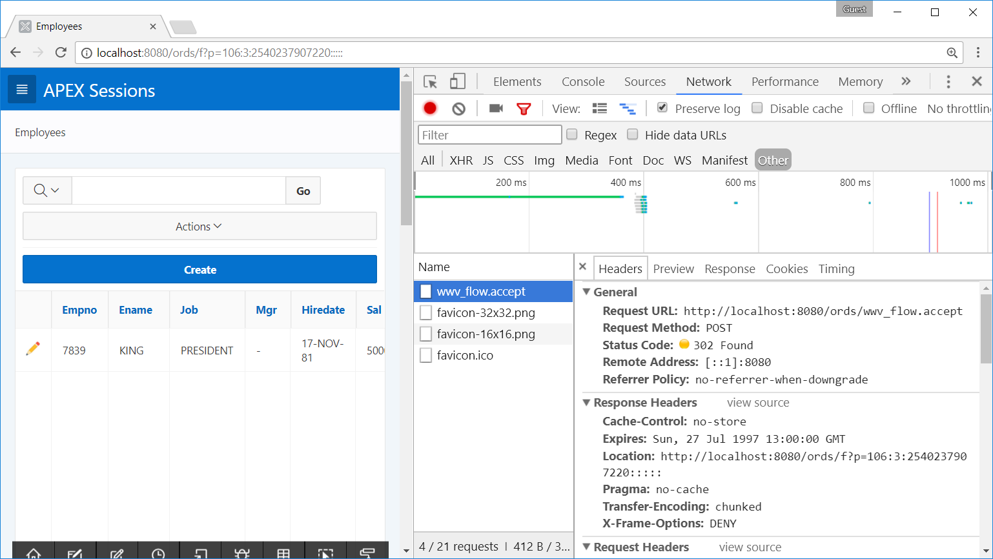
When reload on submit is set to always,
APEX will process the page synchronous
Notes:
Here we see that it we get a 302 redirect and the browser will follow this URL. This is the pre APEX 5.1 way.

Slide 42
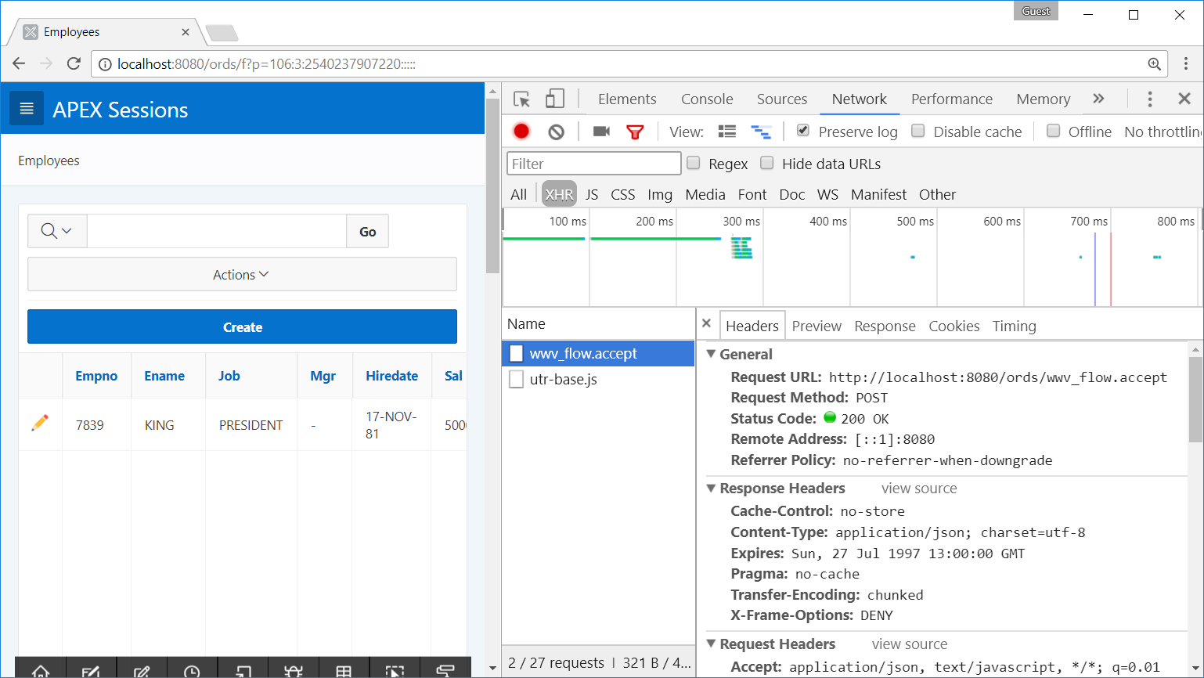
When reload on submit is set to only for success,
APEX will process the page asynchronous
The request returns a URL in JSON format
apex.navigation.redirect( responseData.redirectURL );
Notes:
This is the new way starting in 5.1.
Now we get HTTP OK 200 and do a redirect in JavaScript.
The second combination is with only for success and compatibility mode pre 5.1.
Client side validations is also a new 5.1 feature.
For now client side validations only check for required fields.
Setting compatibility mode to pre 5.1 disables client side validation.
But
#### Ik krijg dit nu wel voor elkaar ###

Slide 43
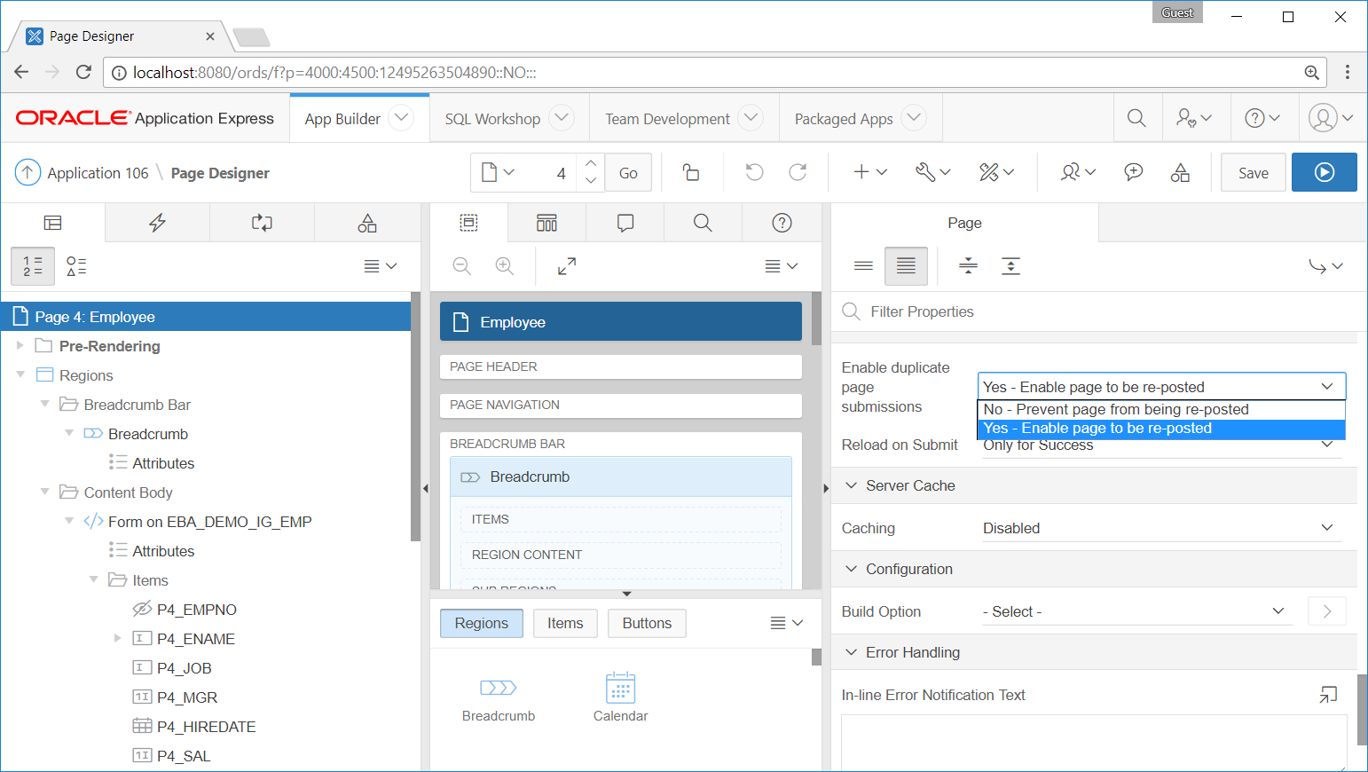
Tip:
Do not use Reload on Submit set Only for Success in combination with Enable Duplicate Page Submissions set to No
This will result in an error when first submit is not successful
Notes:
So this is the first combination of settings that you must use carefully
Because the page was not reloaded when an error occured but the page was already submitted.

Slide 44
Demo

Slide 45
Rejoin Sessions
Notes:
Two interesting features are Rejoin Session and Deeplinking.
First of all Rejoin session

Slide 46
Rejoin sessions
When is it useful?
User is already working in application
Opens a link to the same application in another tab
Via link in email
Via bookmark
Other..

Slide 47
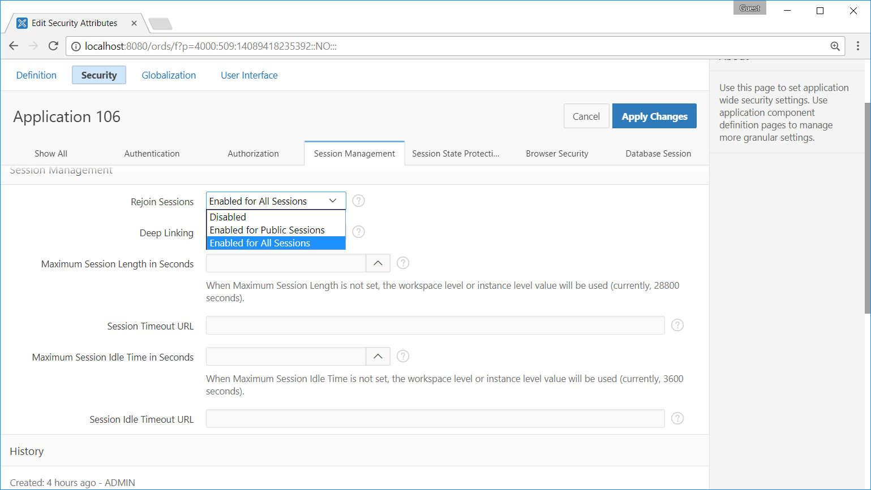
Notes:
What this means is that the sentry function no longer uses the Session ID in the URL.
It only uses the Authentication Scheme Cookie to validate a session.
The result is that you can have a link or bookmark to a page in your application and when you are already logged in (in another tab), it will join that session and use the same session ID.
You might think, this is great, I can now send emails which link to some detail page and let the users do something there.
But no, you can’t set items, request, trigger on demand processes without a checksum in the URL. So the actual usability of the feature is quite limited.

Slide 48
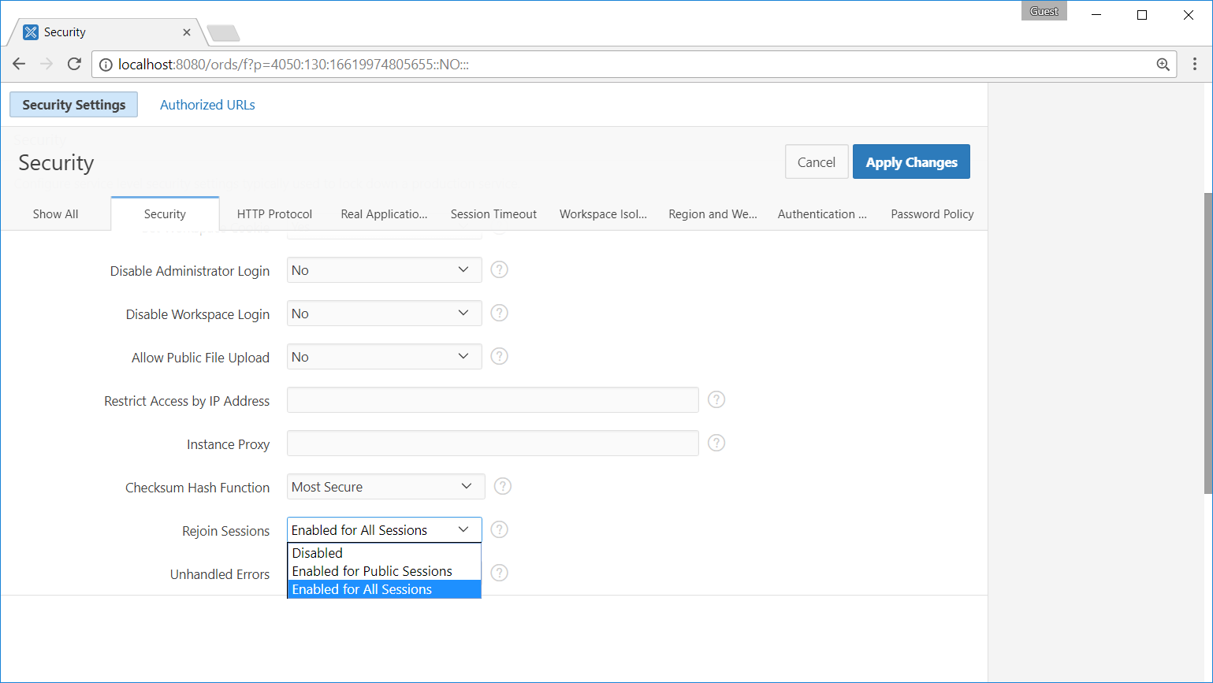
Rejoin sessions needs to be enabled in the Instance Administration

Slide 49
Demo
Notes:
Enable session state
Go to page without session id
Goto page and set item
Enable checksum
Repeat set 3 -> error

Slide 50
Session cloning

Slide 51
APEX session isolation between multiple browser tabs
When is it useful?
When you depend on page/ application items that are not part of page submission
For example: an application item that holds a certain context value
Tab 1: Context is customer A
Tab 2: Context is customer B
Security risks are not fully guaranteed yet, therefore option is disabled by default

Slide 52
Step 1: enable feature
begin
apex_instance_admin.set_parameter(
p_parameter => 'CLONE_SESSION_ENABLED',
p_value => 'Y'
);
end;

Slide 53
Step 2: add navigation bar list entry for this URL
f?p=&APP_ID.:&APP_PAGE_ID.:&APP_SESSION.:APEX_CLONE_SESSION

Slide 54
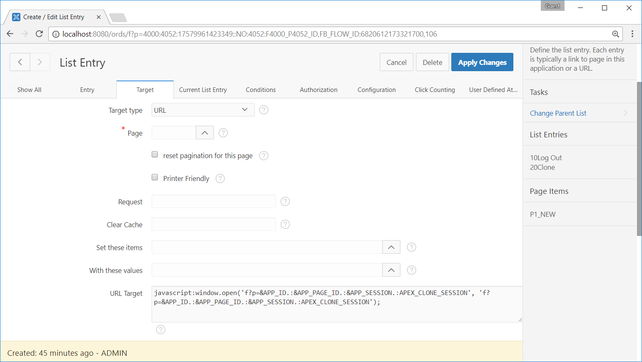
javascript:window.open(
'f?p=&APP_ID.:&APP_PAGE_ID.:&APP_SESSION.:APEX_CLONE_SESSION', 'f?p=&APP_ID.:&APP_PAGE_ID.:&APP_SESSION.:APEX_CLONE_SESSION'
);

Slide 55
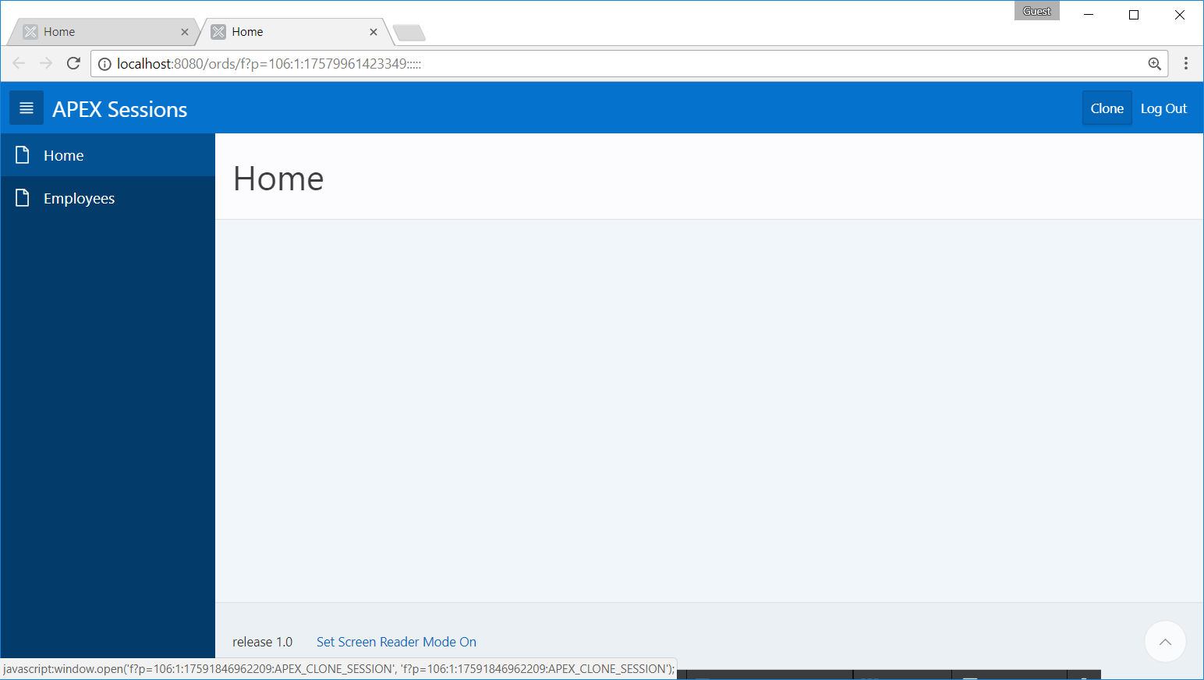

Slide 56
Demo

Slide 57
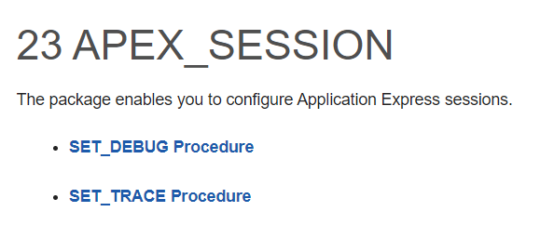
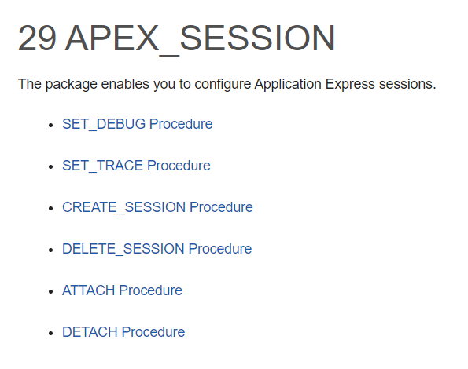
APEX_SESSION Package
5.1
18.1

Slide 58
The logout process

Slide 59
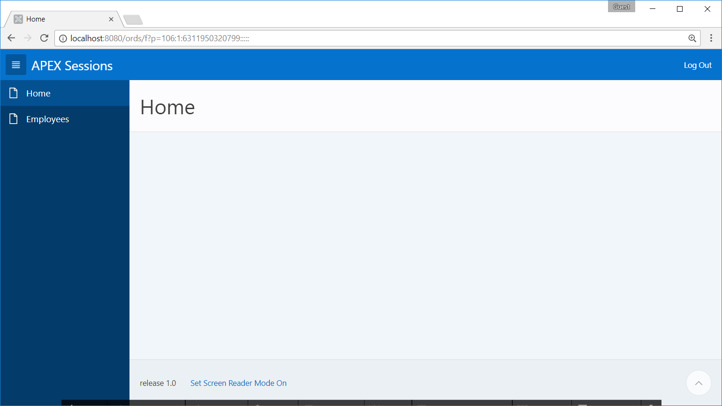
Logout URL: &LOGOUT_URL.
apex_authentication.logout?p_app_id=106&amp;p_session_id=6311950320799
Session is purged and no longer in apex_workspace_sessions view

Slide 60
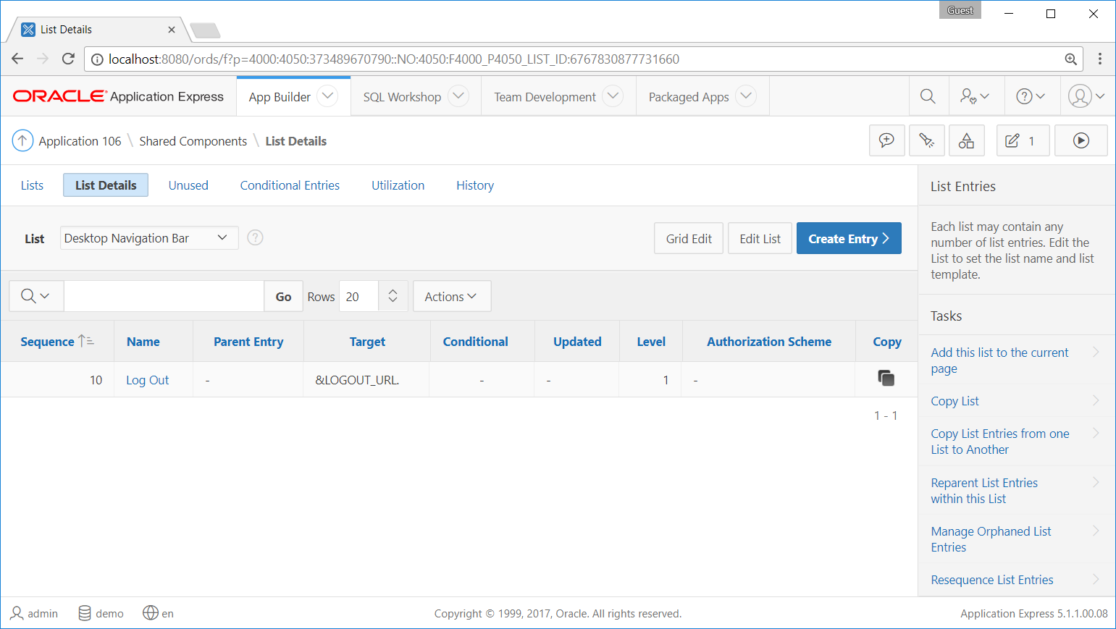

Slide 61
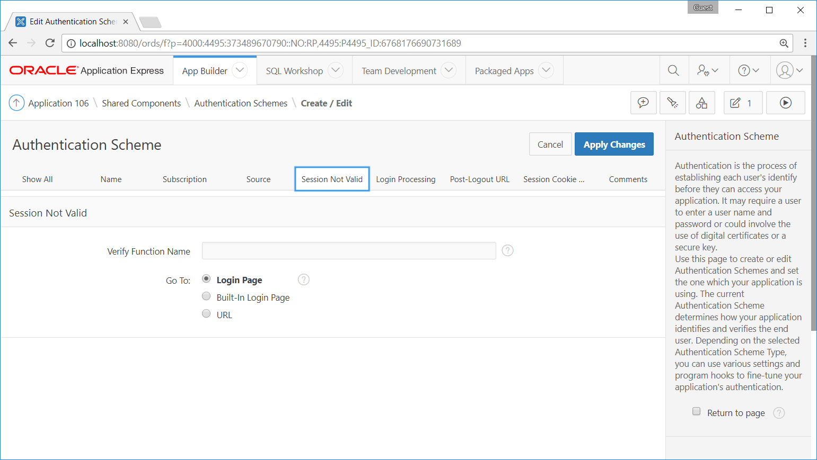

Slide 62
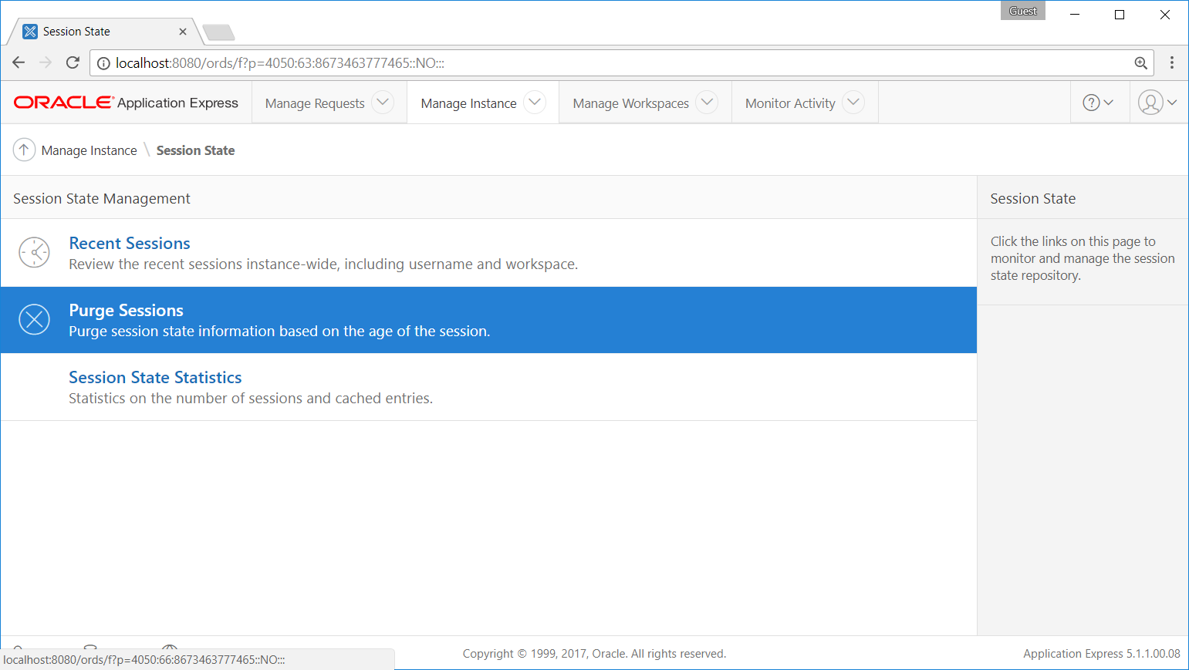

Slide 63
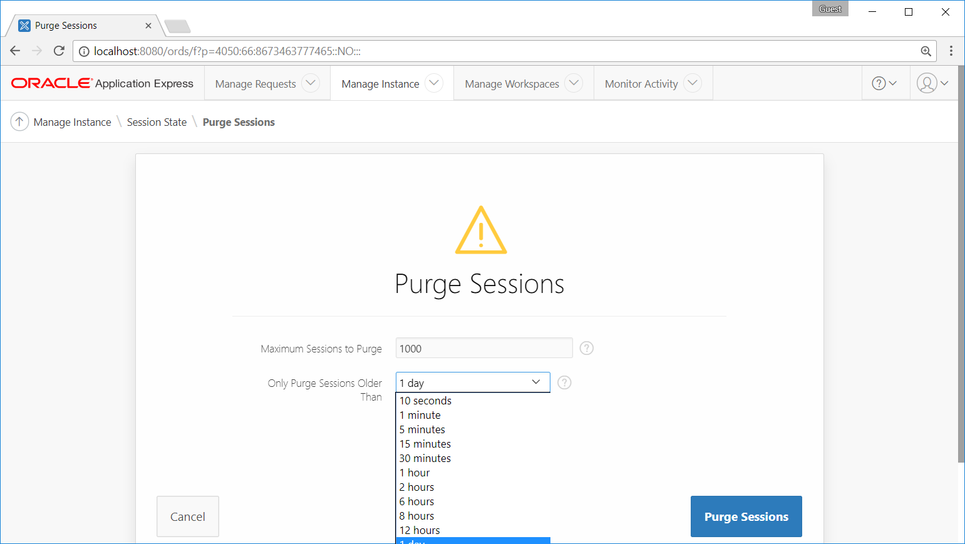
You can purge all instance sessions

Slide 64
Thank you

